Slide 1


Pulling it all together From protein sequences to PPI networks and beyond
Tamás Korcsmáros

Slide 2
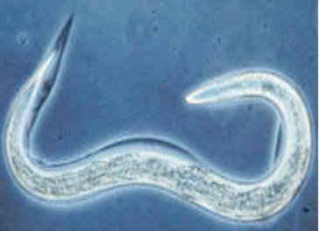
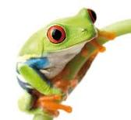
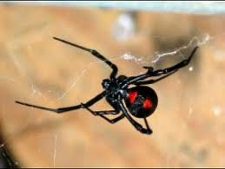
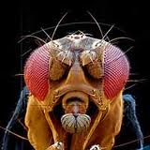
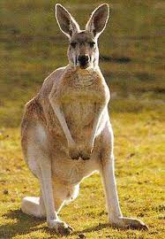

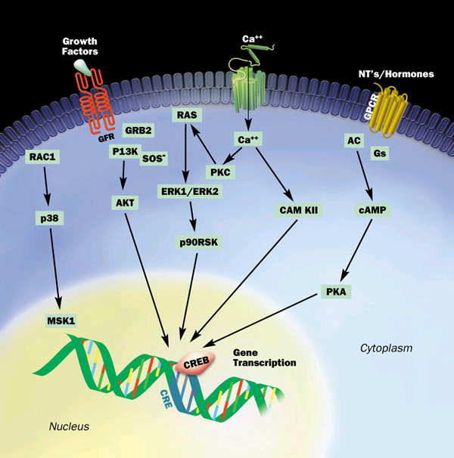
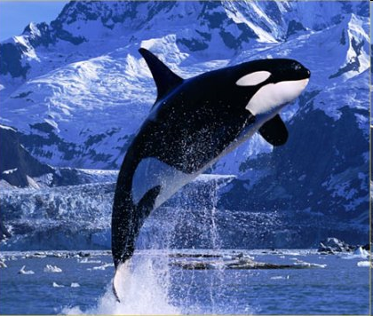
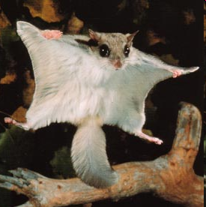
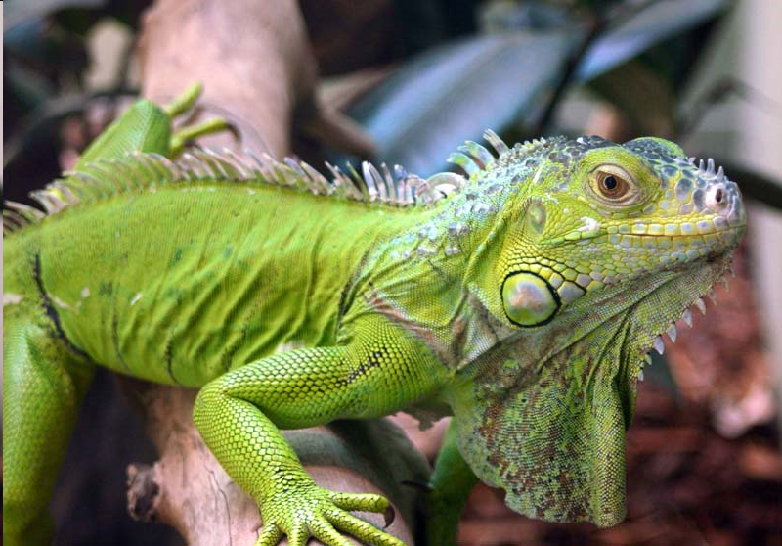
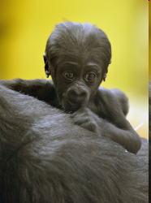

Why am I interested in PPIs?
Contradictions
Many cell types and phenotypes
But relatively low number of signalling proteins
Relatively low number of signalling pathways

Slide 3
Thematics
From pathways to networks
Visualization challenges and solutions
Extending pathways
Data integration
Power of prediction
Use cases for data integration
SignaLink 2
Salmonella-autophagy

Slide 4
Signalling pathways and networks
Pathway definitions are not identical
Curation rules are not uniform
Not enough and identical details / sources
Cross-talks and overlaps (multi-pathway proteins) cannot be examined (easily)
Problems and challenges in signalling pathway databases
Input Ligands
Pathway mediators (cross-talk proteins)
Output Transcription factors

Slide 5
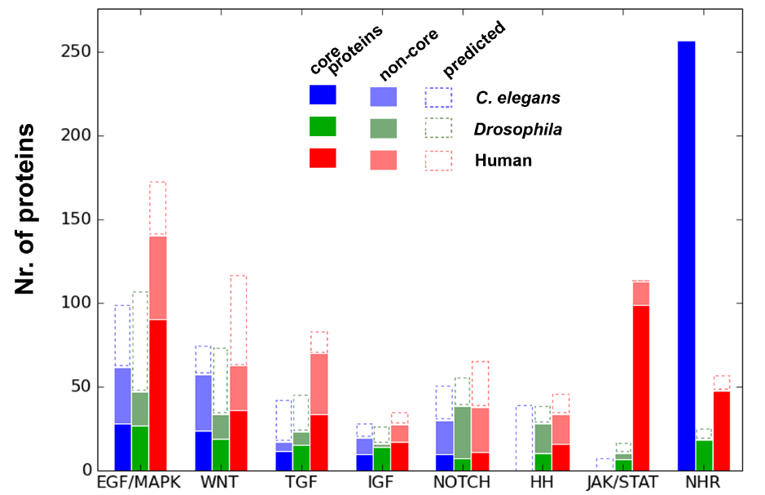
The SignaLink database
http://SignaLink.org
3 metazoans
8 biochemically defined pathways
Manually curated, uniform curation rules
All interactions are directed and link to experimental research articles
Contains multi-pathway proteins and cross-talks
Versions: 2006, 2008, 2012*
Compared to 3 pathway databases
SignaLink contains the highest number of proteins, interactions, cross-talks and literature sources (between the examined pathways)
Allows the system-level examination of the signalling network
Korcsmaros et al., Bioinformatics (2010), PLoS ONE (2011)

Slide 6
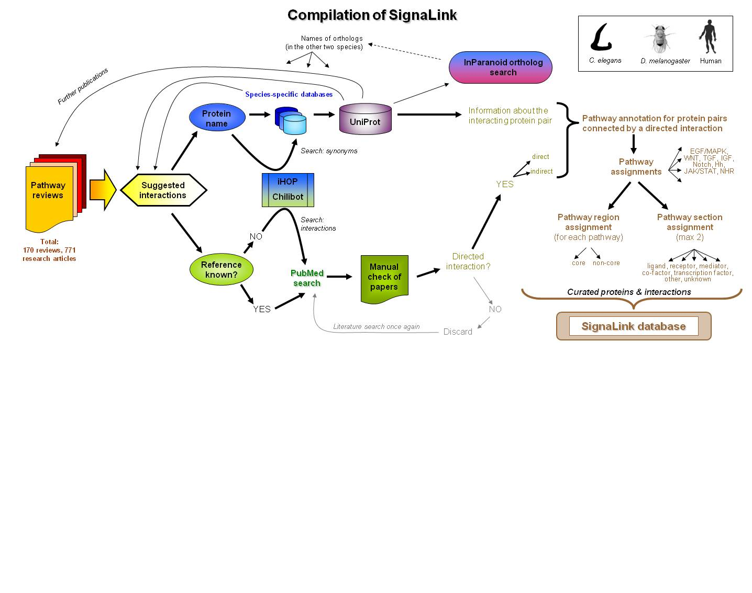
Curation protocol of SignaLink

Slide 7
Network of signalling pathways
How can we visualize cross-talks?

Slide 8
Network of signalling pathways
1) Color-coded protein-protein interaction network
2) Cross-talk network

Slide 9
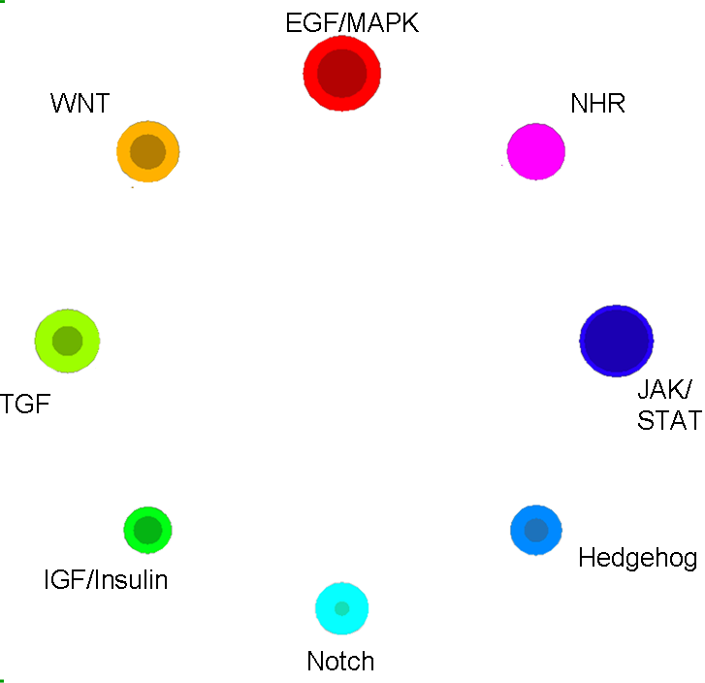
Network of signalling pathways

Slide 10
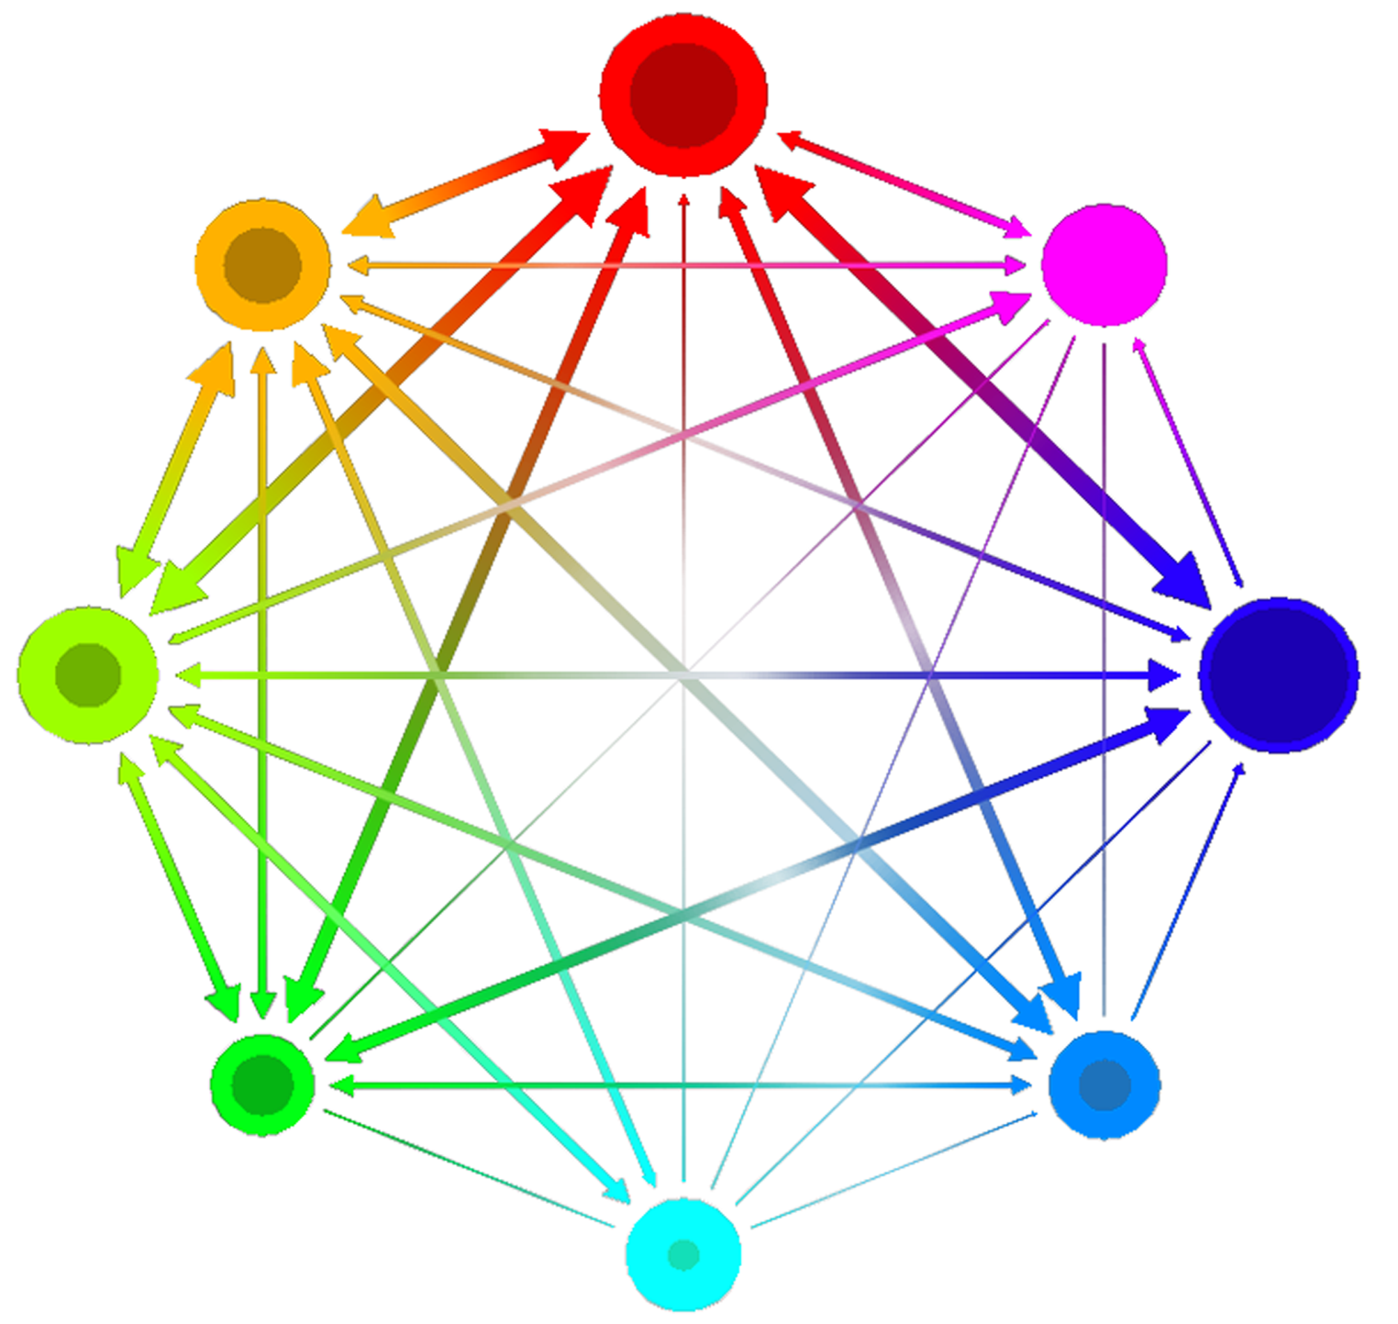
EGF/MAPK
WNT
NHR
JAK/ STAT
TGF
Hedgehog
IGF/Insulin
Notch

Slide 11
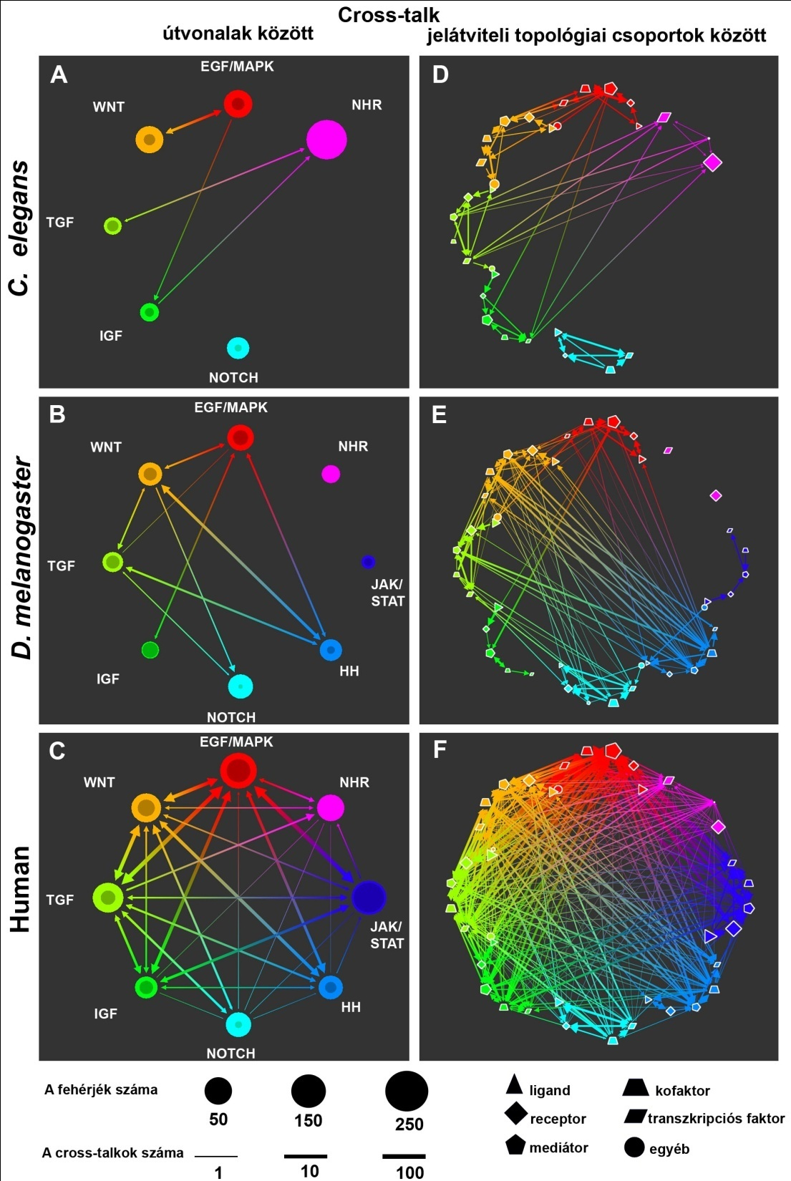

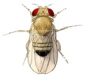

Cross-talk networks in 3 metazoans
NHR
Nr. of proteins
Nr. of cross-talks
Korcsmaros et al., Bioinformatics (2010)

Slide 12
Detailed cross-talk networks in 3 metazoans
ligand
co-factor
receptor
transcription factor
mediator
other
Korcsmaros et al., Bioinformatics (2010)

Slide 13
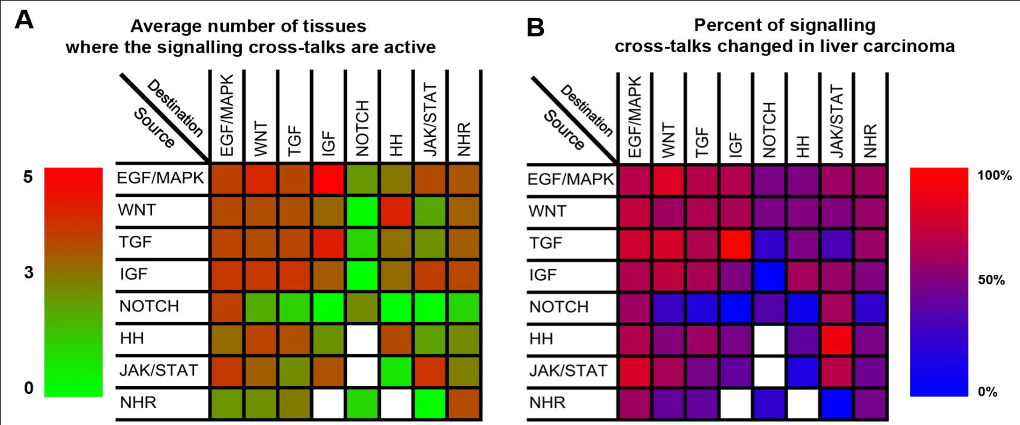
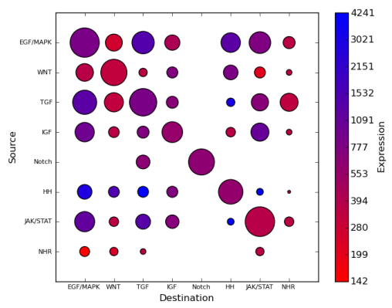
Visualizing cross-talk expressions
Identification of tissue-, disease-, and cell-type specific cross-talks
Korcsmaros et al., Bioinformatics (2010)

Slide 14
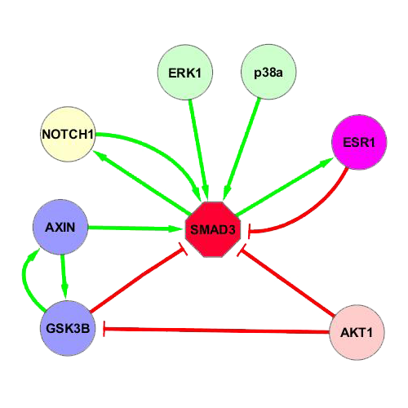
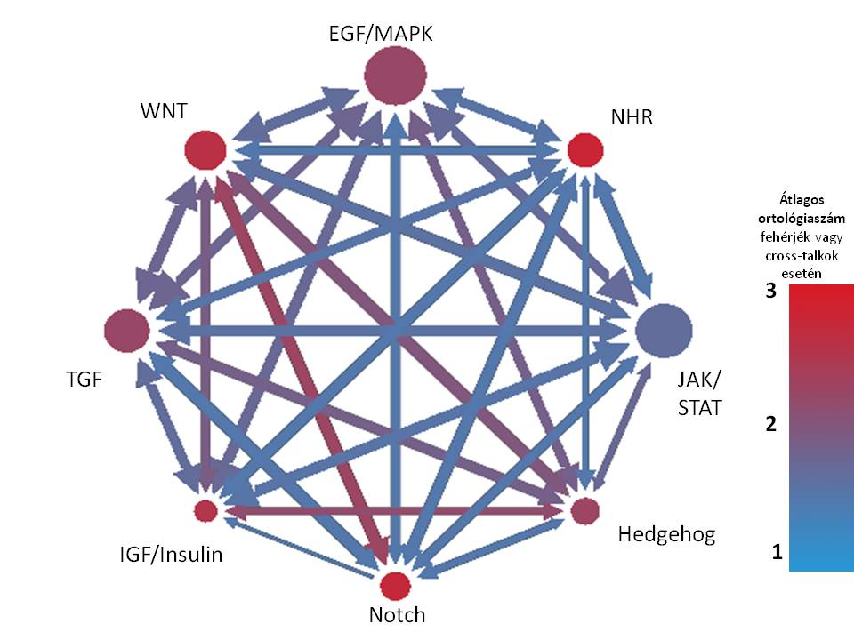
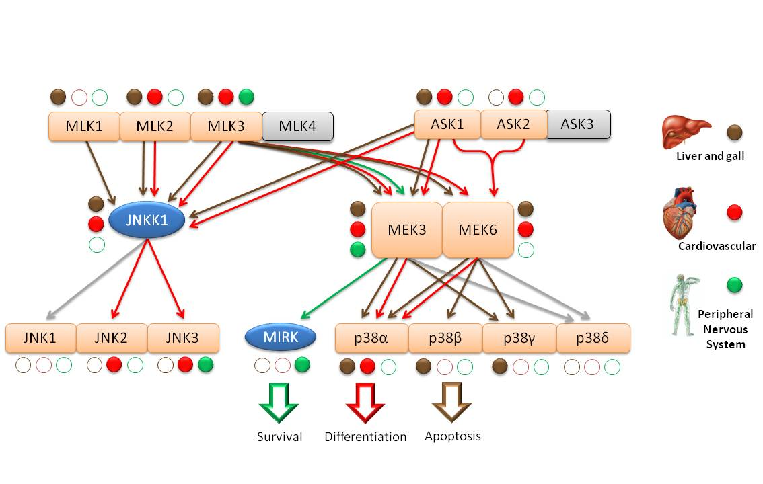
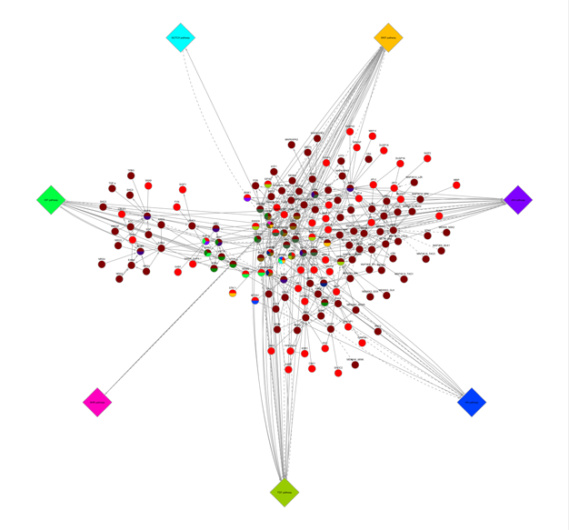
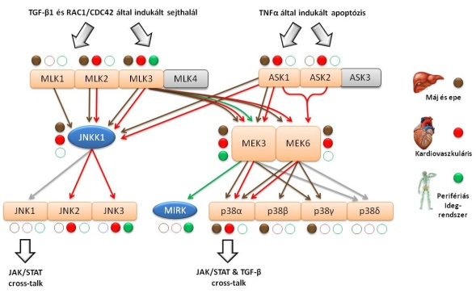
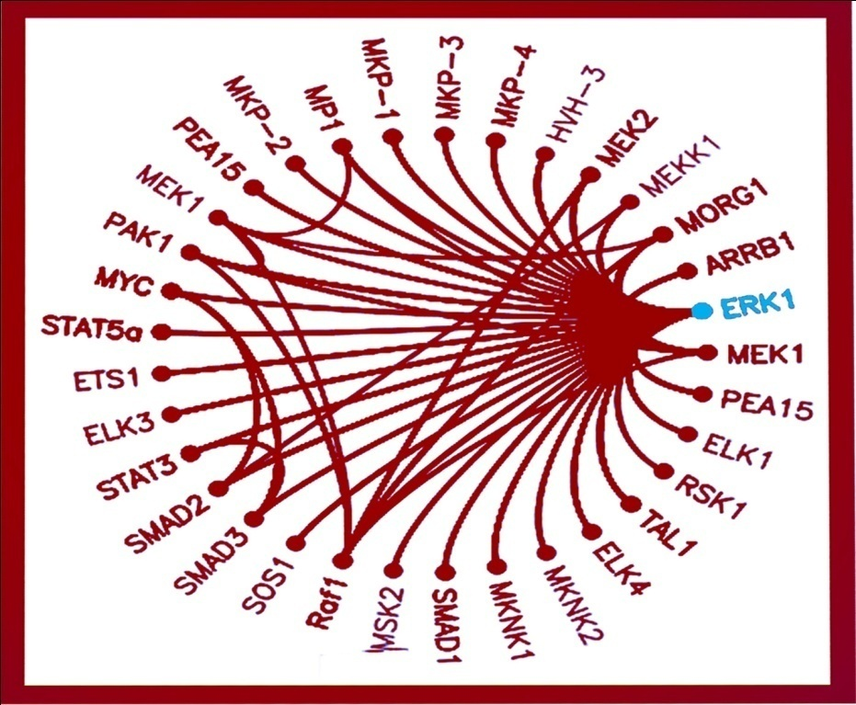
Further cross-talk analyses and visualizations
EGF/MAPK
WNT
NHR
Cross-talk network
TGF
JAK/ STAT
IGF/Insulin
Hedgehog
Average nr. of ortholog proteins or cross-talk
Notch
Cross-talking pathways
Cross-talking proteins

Slide 15
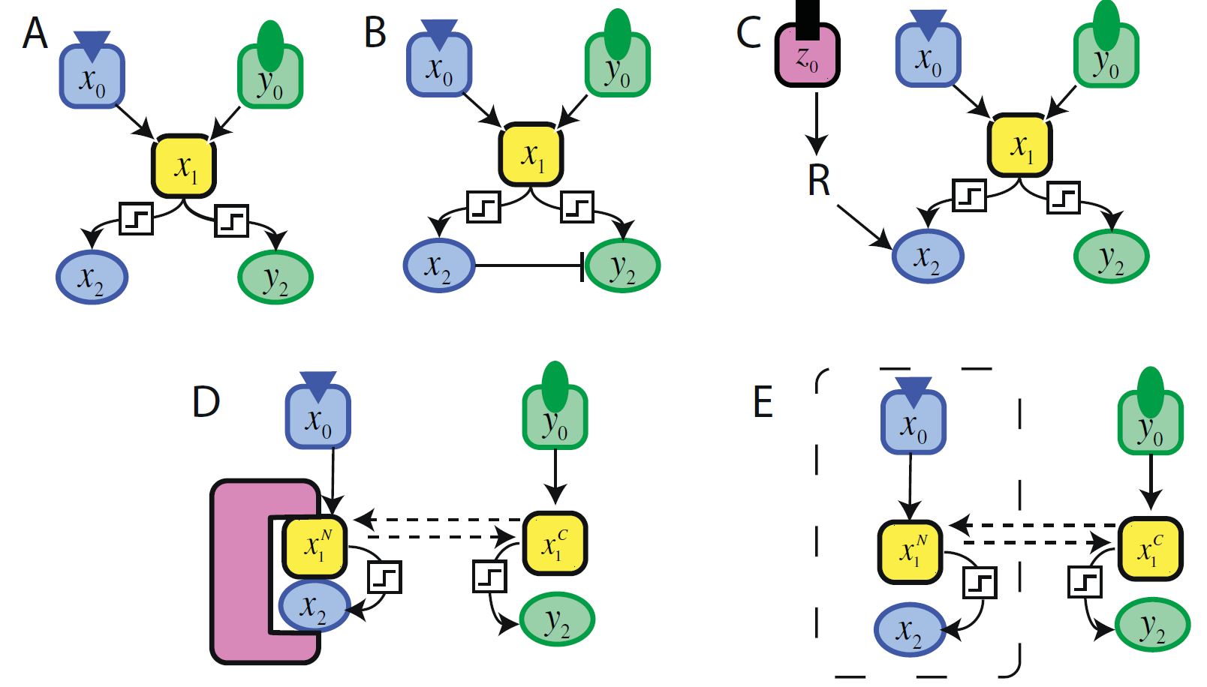
Multi-pathway proteins and the direction of signalling flow
A solution for the contradictions?
Combinatorial problems
Many cell types and phenotypes
But relatively low number of signalling proteins
Relatively low number of signalling pathways
Protein isoforms
Alternative splicing
Post-translational sites
How cross-talks and signalling flow are regulated?

Slide 16
Insulating mechanisms to regulate signalling flow
Cross-pathway inhibition
Combination of signalling
Scaffolds
Compartmentalization
Haney et al., BMC Systems Biology (2010)

Slide 17
Precise regulation of signalling pathways is important.
Extending signalling pathways

Slide 18

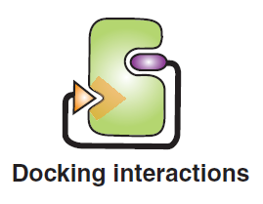
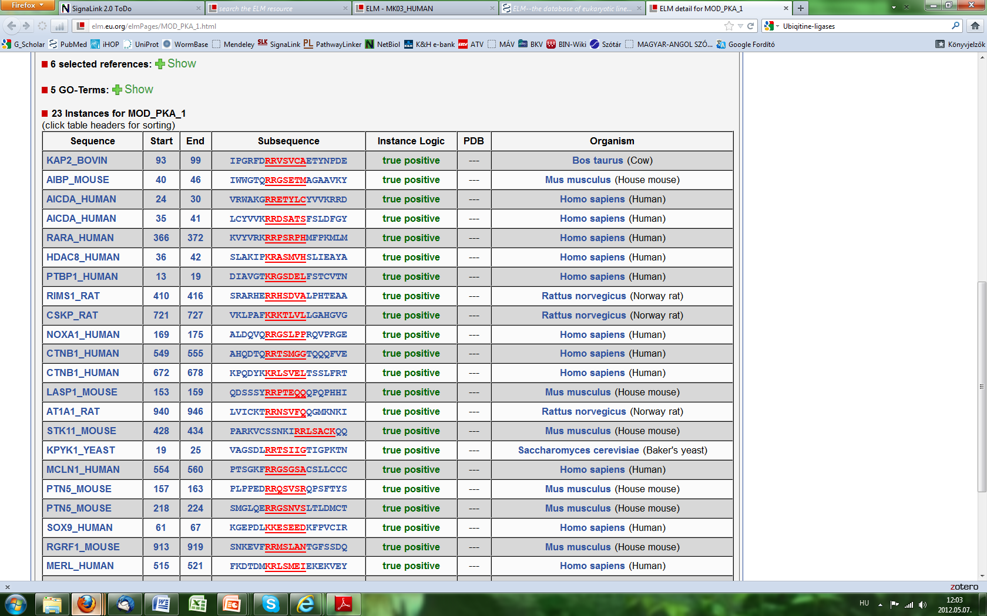
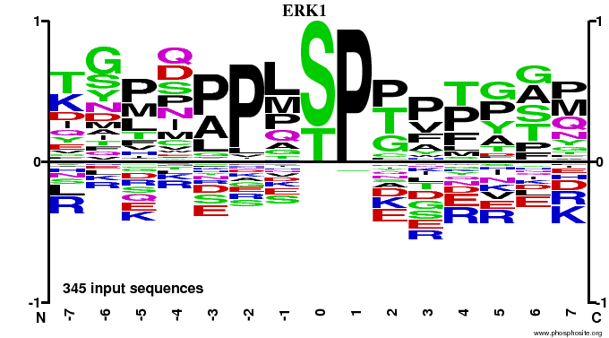
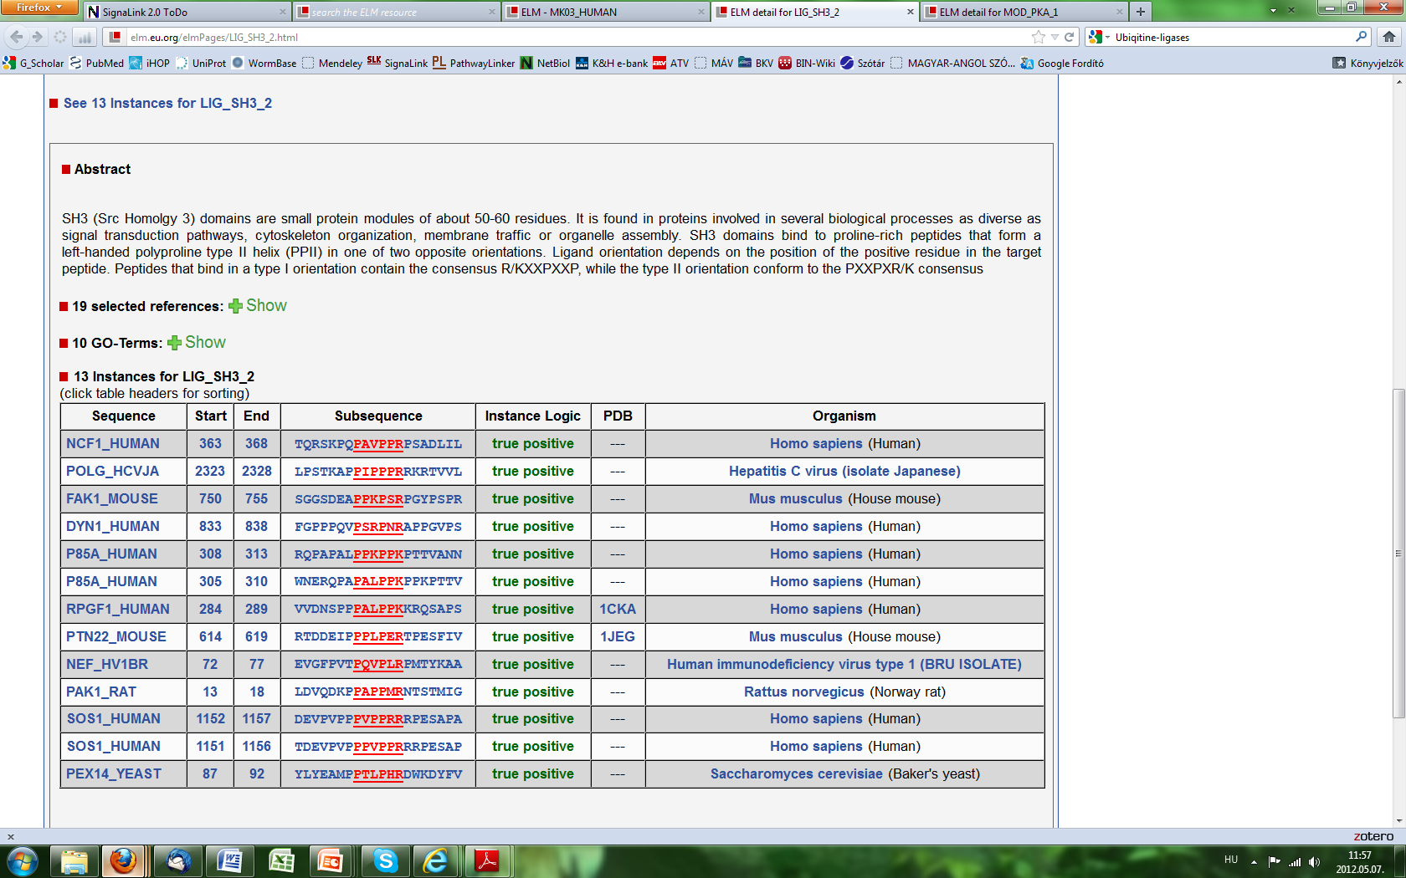
Regulation of signalling duration
Kinases, phosphatases, ubiquitin-ligases, peptidases, etc.
Resources of post-translational modifications (PTMs)
Reversible or irreversible modulation of specific proteins
Priming, activation, temporal de-activation, cleavage, destruction, etc.
NetworKIN (http://networkin.info)
Phosphosite (http://phosphosite.org)
dbPTM (http://dbptm.mbc.nctu.edu.tw)
ELM server (http://elm.eu.org)
…
Specificity?
Target motifs
Docking motifs
P..P.[KR]
Dinkel et al., Nucleic Acids Res. (2012); Bhattacharyya et al., Annu. Rev. Biochem. (2006)

Slide 19
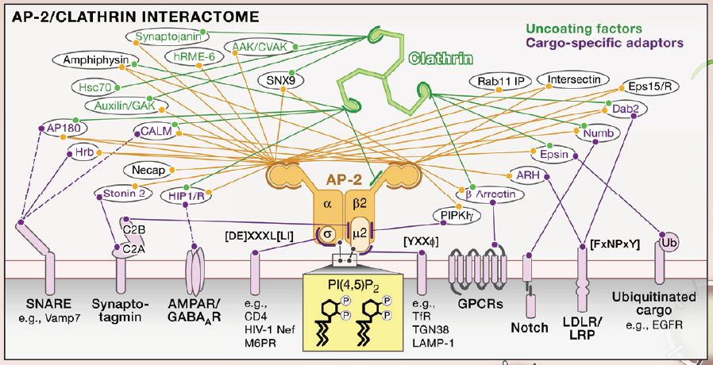
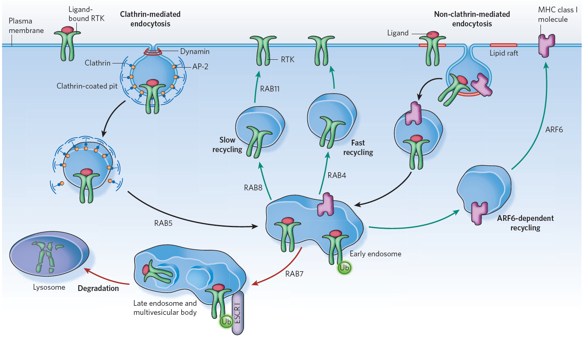
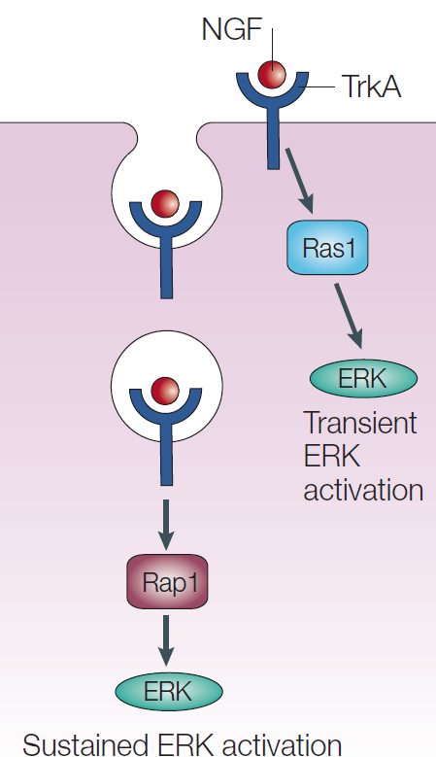
Spatial regulation of signalling by endocytosis
Specific down-regulation, recycling, destruction or signal modulation by general and cargo-specific factors
Scita & Di Fiore, Nature (2010); Wieffer et al., Cell (2009); Gould & Lippincott-Schwartz, Nat.Mol.Cell.Biol (2009)

Slide 20
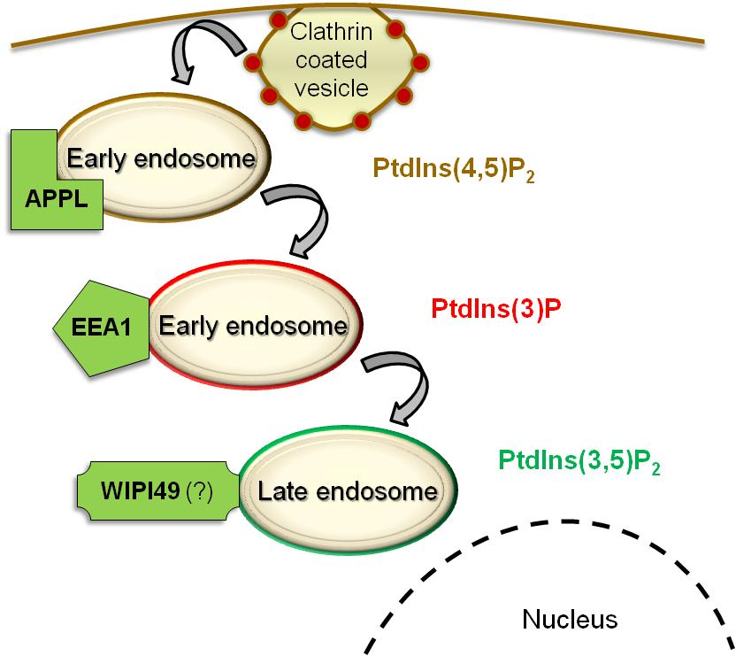
Palfy, Remenyi, Korcsmaros (Trends in Cell Biol, 2012)
An opinion: Cross-talk endosomes
Input 1
Input 2
Cross-talk
X
Y
Scaffold
EL
Endosome
Output 1
Output 2

Slide 21
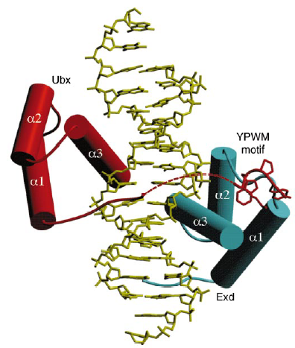
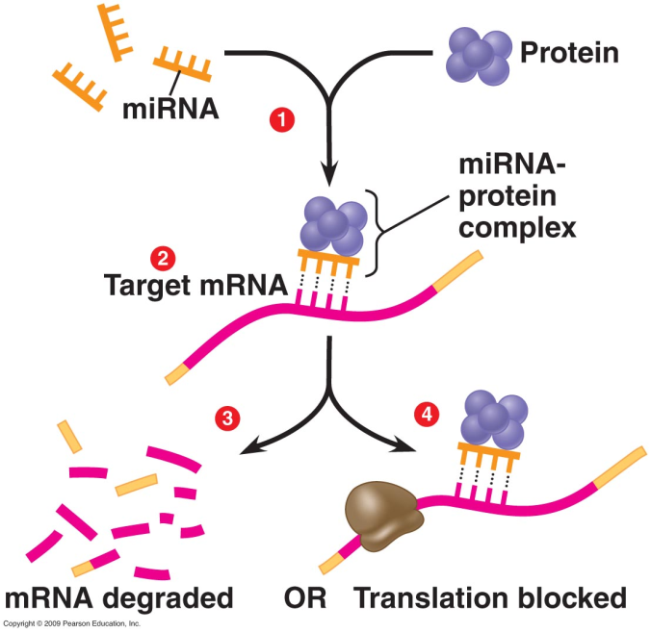
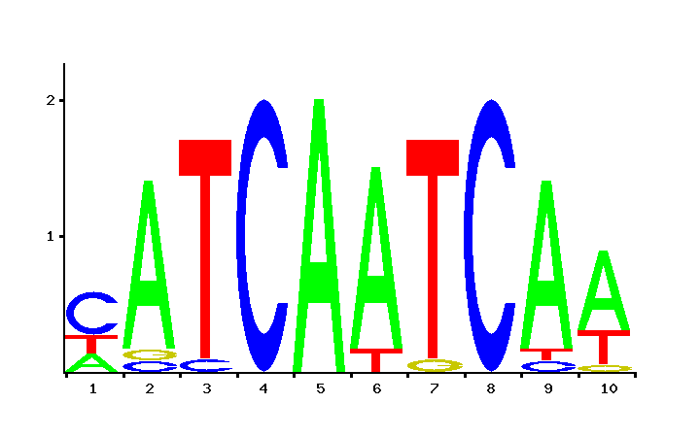
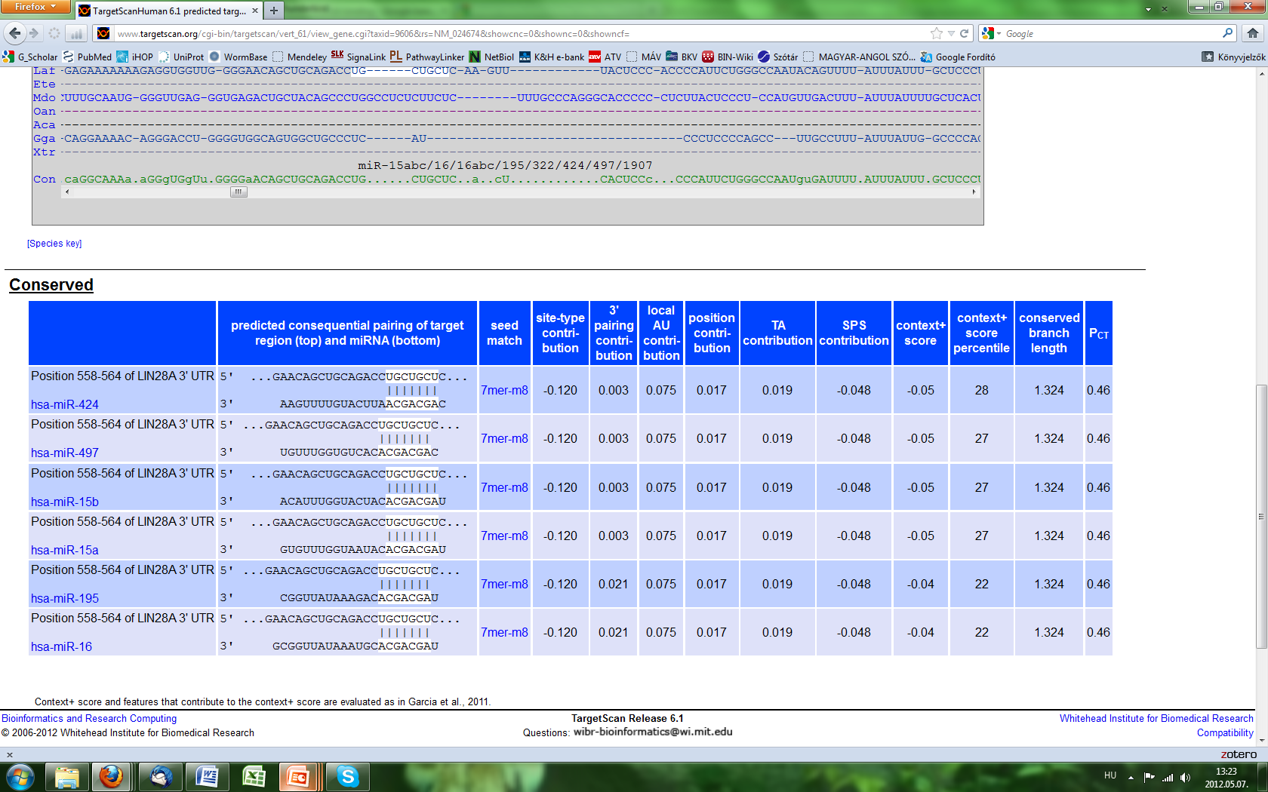
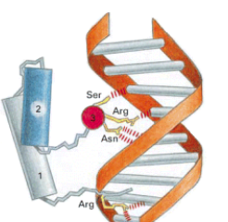
Regulating the expression of signalling components
Transcriptional regulation
Post-transcriptional regulation
Activation or inhibition of specific gene expression by transcription factor – transcription factor binding site connection
JASPAR (http://jaspar.genereg.net)
TFe (http://cisreg.ca/cgi-bin/tfe/home.pl)
HTRIdb (http://www.lbbc.ibb.unesp.br/htri)
PAZAR (http://pazar.info)
Destruction or inhibition of specific mRNAs by miRNAs
miRBase (http://mirbase.org)
miRGen (http://diana.cslab.ece.ntua.gr/mirgen)
miRecords (http://mirecords.umn.edu/miRecords)
TarBase (http://www.microrna.gr/tarbase)
Specificity?
TF-TFBS target motifs
mRNA-miRNA binding

Slide 22
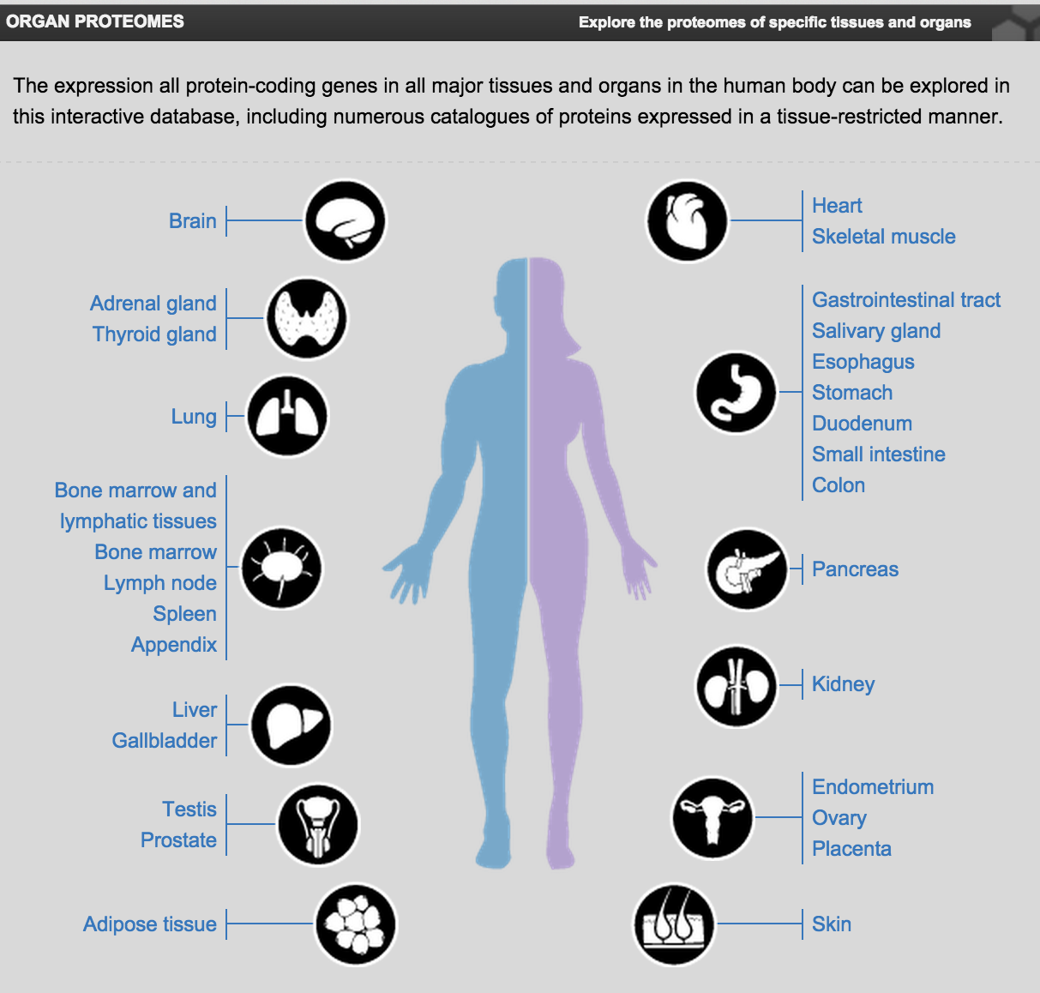
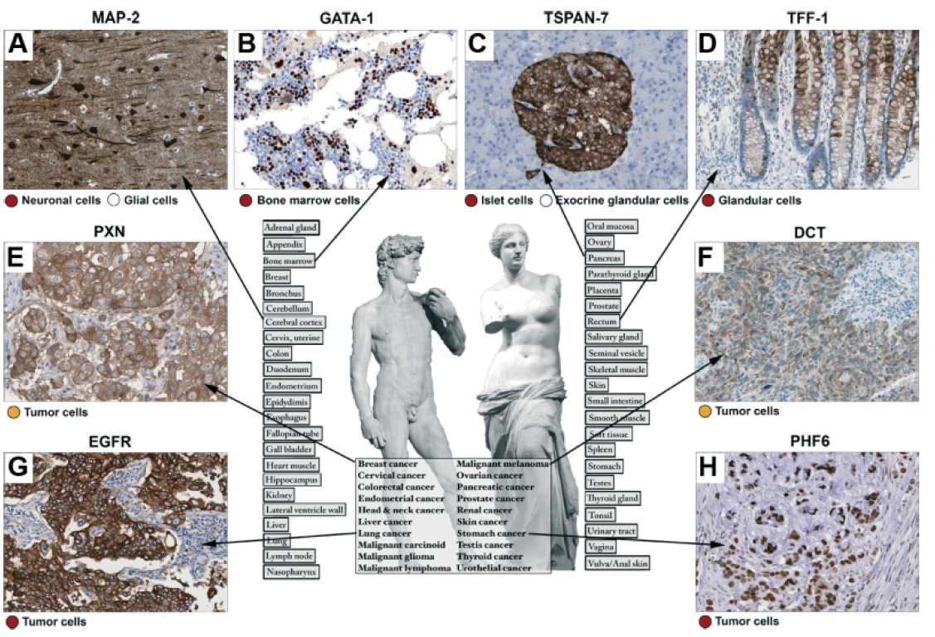
An important issue: tissue specificity
Human Protein Atlas http://proteinatlas.org
High-resolution images
Spatial distribution of proteins
44 different normal human tissues and 20 different cancer types
46 different human cell lines
Uhlen et al., Nat Biotechnol. (2010), Uhlen et al., Science (2015)

Slide 23
Legends:
Signalling elements
Transcription factors
Cell membrane
Types of networks:
Network of signalling pathways
Nucleus
DNA

Slide 24
Legends:
Signalling elements
Transcription factors
Cell membrane
Types of networks:
Network of signalling pathways
Network of transcription factors
Nucleus
DNA

Slide 25
Legends:
Signalling elements
Transcription factors
Promoters
Cell membrane
Types of networks:
Network of signalling pathways
Network of transcription factors
Nucleus
Network of transcription factors’ binding sites
DNA

Slide 26
Legends:
Signalling elements
Transcription factors
Promoters
Cell membrane
miRNAs
Types of networks:
Network of signalling pathways
Network of transcription factors
Nucleus
Network of transcription factors’ binding sites
Network of promoters and their transcripts
DNA

Slide 27
Legends:
Signalling elements
Transcription factors
Promoters
Cell membrane
miRNAs
Types of networks:
Network of signalling pathways
Network of transcription factors
Nucleus
Network of transcription factors’ binding sites
Network of promoters and their transcripts
Network of miRNAs and transcripts
DNA

Slide 28
Reactome
SignaLink
ConsensusPathDB
…
Component data
Legends:
Signalling elements
wTF2.1
FlyTF
A census of human TFs
Transcription factors
Fantom4
MPromDB
Promoters
miRBase
miROrtho
ABS
TRED
RedFly
EdgeDB
JASPAR
TFe
HTRIdb
ENCODE
miRNAs
Types of networks:
Network of signalling pathways
Network of transcription factors
Interaction data
MPromDB
miRGen
PutMir
TransMir
Network of transcription factors’ binding sites
Network of promoters and their transcripts
miRecords
TarBase
ENCODE
Network of miRNAs and transcripts

Slide 29
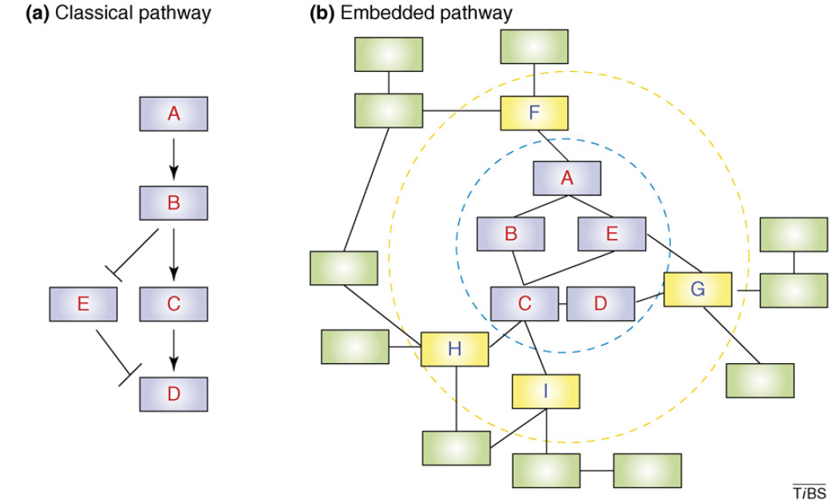
Embedding pathways into interaction networks
Trends Biochem Sci, 32: 320–331 (2007)

Slide 30
Where can I find PPIs to connect with my pathway?

Slide 31
The power of prediction Applying sequence and structural information to predict novel functions / connections

Slide 32
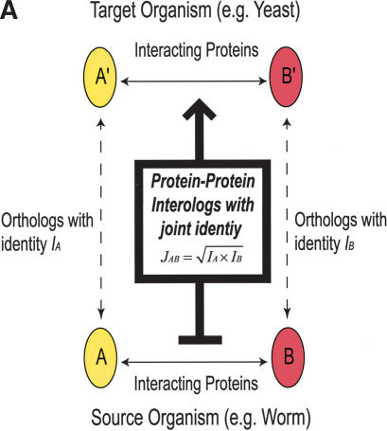
Protein-protein interactions
Predicted interactions
Homology/orthology-based (interologs)
Domain-motifs based (directed)
Domain-domain based (interaction & direction)
Yu et al., Genome Research (2006)

Slide 33
Protein-protein interactions
Predicted interactions
Homology/orthology-based (interologs)
Domain-motifs based (directed)
Domain-domain based (interaction & direction)
Yu et al., Genome Research (2006)

Slide 34
Protein-protein interactions
Predicted interactions
Homology/orthology-based (interologs)
Domain-motifs based (directed)
Domain-domain based (interaction & direction)
Yu et al., Genome Research (2006)

Slide 35
Protein-protein interactions
Predicted interactions
Homology/orthology-based (interologs)
Domain-motifs based (directed)
Domain-domain based (interaction & direction)
Protein sequence of a protein of interest (eg., from UniProt)
Domain-motif database (eg., ELM server)
Enzymatic domain capable to target the protein
Predicted PPI based on
domain-motif interaction

Slide 36
Protein-protein interactions
Predicted interactions
Homology/orthology-based (interologs)
Domain-motifs based (directed)
Domain-domain based (interaction & direction)
Domain-domain interaction data (eg., DOMINE)
Protein-domain composition data (eg., PFAM)
Possible domain pairs
Predicted PPI based on
domain-domain interaction

Slide 37
Protein-protein interactions
Predicted interactions
Homology/orthology-based (interologs)
Domain-motifs based (directed)
Domain-domain based (interaction & direction)
Directed PPI from the reference database
(eg., Reactome)
Domain composition as training set
(eg., PFAM)
Liu et al., MCP (2009) and Rhodes et al., Nature Biotechnology (2005)

Slide 38
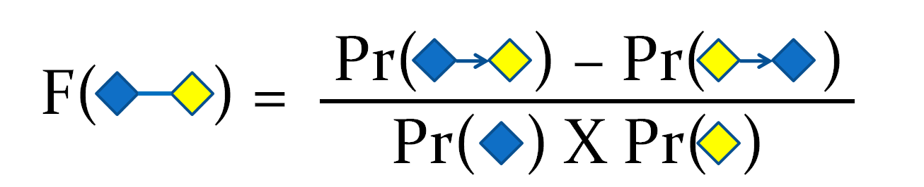
Protein-protein interactions
Predicted interactions
Homology/orthology-based (interologs)
Domain-motifs based (directed)
Domain-domain based (interaction & direction)
Domain composition as training set
(eg., PFAM)
Liu et al., MCP (2009) and Rhodes et al., Nature Biotechnology (2005)

Slide 39
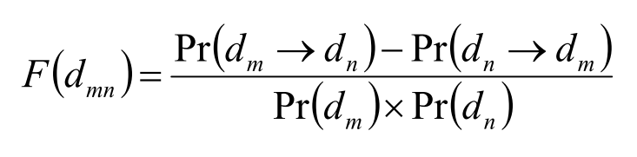
Protein-protein interactions
Predicted interactions
Homology/orthology-based (interologs)
Domain-motifs based (directed)
Domain-domain based (interaction & direction)
Domain composition as training set
(eg., PFAM)
Liu et al., MCP (2009) and Rhodes et al., Nature Biotechnology (2005)

Slide 40
Two use cases for data integration

Slide 41
Reactome
SignaLink
ConsensusPathDB
…
Component data
Legends:
Signalling elements
wTF2.1
FlyTF
A census of human TFs
Transcription factors
Fantom4
MPromDB
Promoters
miRBase
miROrtho
ABS
TRED
RedFly
EdgeDB
JASPAR
TFe
HTRIdb
ENCODE
miRNAs
Types of networks:
Network of signalling pathways
Network of transcription factors
Interaction data
MPromDB
miRGen
PutMir
TransMir
Network of transcription factors’ binding sites
Network of promoters and their transcripts
miRecords
TarBase
ENCODE
Network of miRNAs and transcripts

Slide 42
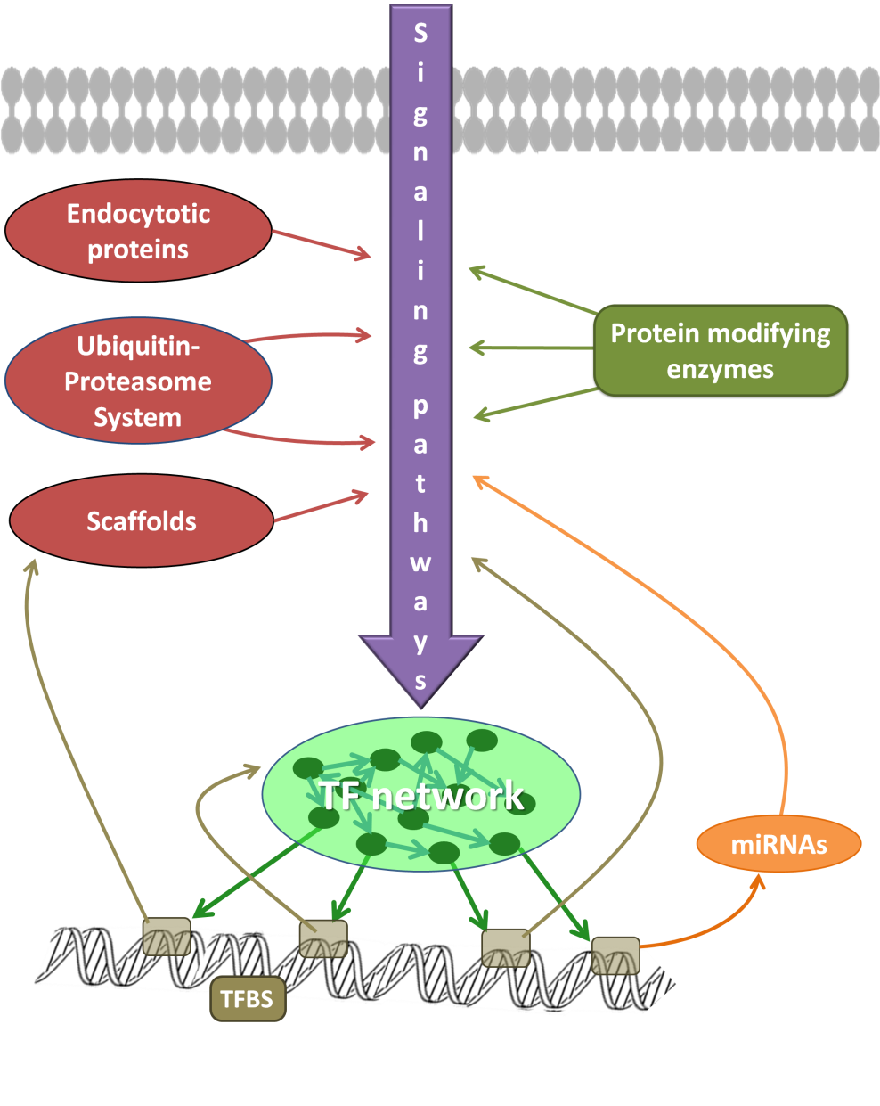
SignaLink 2.0 A signalling pathway resource with a multi-layered regulatory network
Fazekas et al BMC Syst Biol, 2013

Slide 43
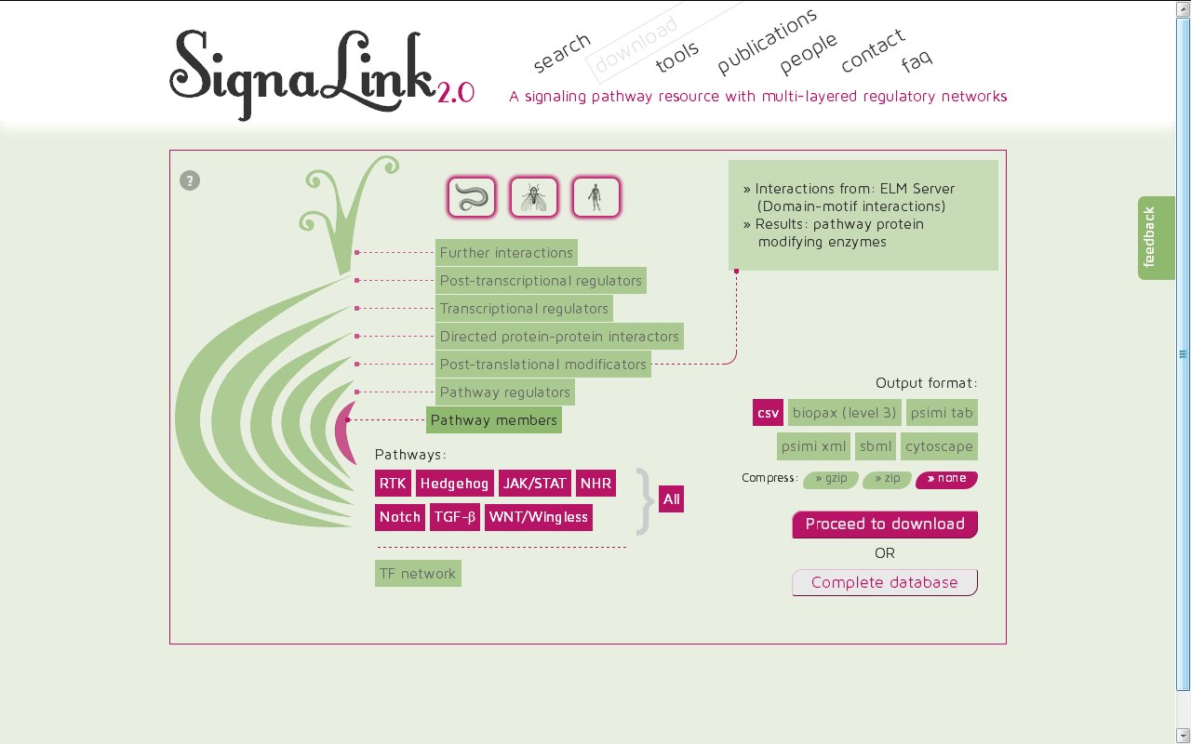

Slide 44
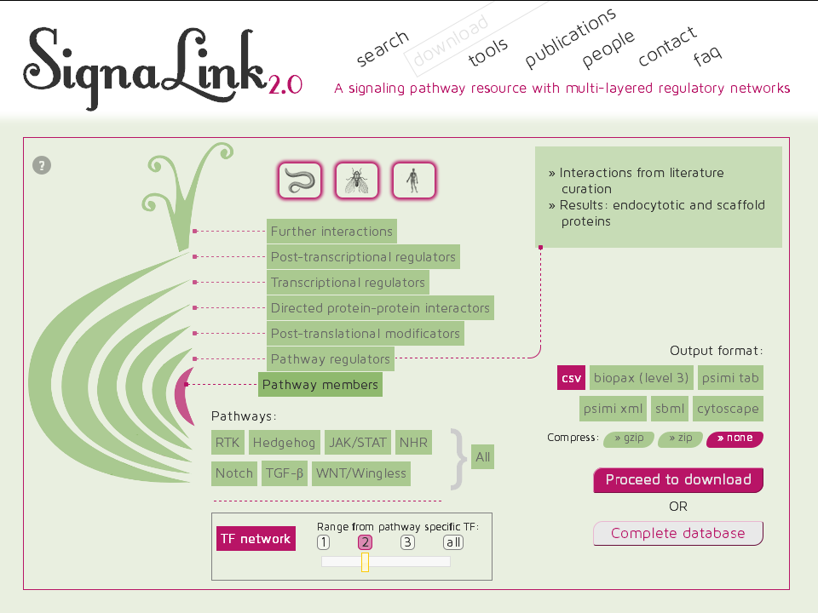

Slide 45
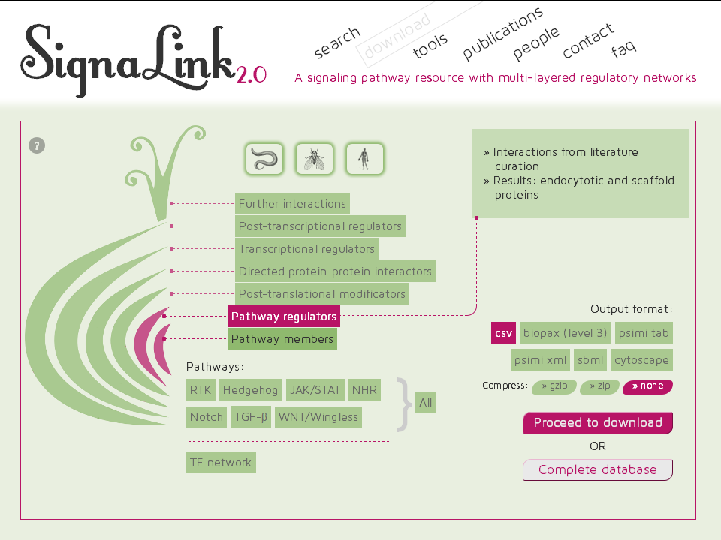

Slide 46
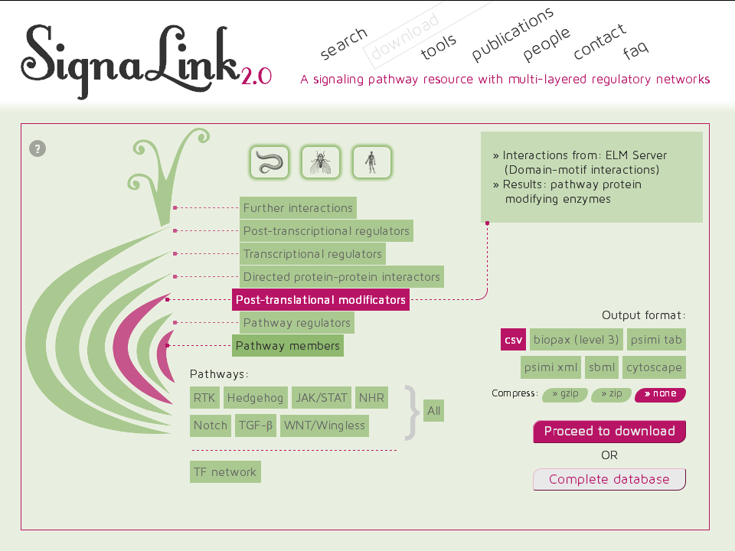

Slide 47
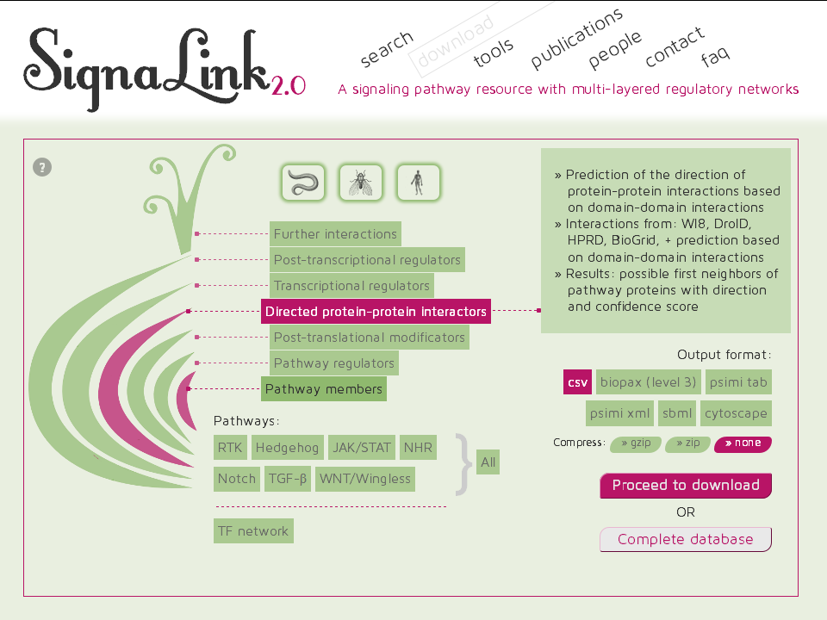

Slide 48


Slide 49


Slide 50


Slide 52
SignaLink 3 – coming soon
Zebrafish
Extended coverage
More signs for PPIs
Linkouts from UniProt, Wormbase, Flybase
http://SignaLink.org

Slide 53
Network medicine
Protein-protein interactions
in infection

Slide 54


Autophagy
Stress response mechanism
starvation
hypoxia
protein misfolding
damaged mitochondria
Target microbes to lysosomal degradation
Also involved in intestinal homeostasis, normal development, inflammation, immune recognition, regeneration, and ageing
Neurodegenerative diseases, diabetes, cancer, IBD (Crohn’s disease)
Several intracellular bacteria can stimulate and/or inhibit autophagy
Helicobacter pylori
Salmonella enterica
Listeria monocytogenes
Shigella flexneri
Notes:
.

Slide 55




Autophagy regulation by Salmonella
Networks needed
In the host
Network of host autophagy components and their regulators
In Salmonella
An integrated network of regulation, protein-protein interactions and metabolism
Host-pathogen interactions
Experimental screening/validation
Autophagy
Salmonella
Cellular network of an intestinal cell

Slide 56


Autophagy Regulatory Network
A manually curated dataset of autophagy components and their interactions
Integrated resource with known enzyme regulators of autophagy
Contains transcription factors and miRNAs regulators of autophagy
Can be downloaded in a user-specified content and format
Turei et al. Autophagy (2015)
http://autophagy-regulation.org

Slide 57

Reconstruction of Salmonella molecular networks
Figure modified from Gonçalves et al, Mol Biosyst, 2013
Notes:
This is the whole network of a Salmonella.-

Slide 58

Reconstruction of Salmonella molecular networks
SIGNALLING/PROTEIN-PROTEIN
INTERACTION NETWORK
Sources
- Small-scale data by manual curation
- Large-scale data from high-throughput experiments imported from databases (IntAct, BioGrid)
- Structure based predictions from Interactome3d
- Ortholog-based predictions from E. coli
Notes:
The PPI network (it was my part), means the direct interaction of the proteins,

Slide 59

Reconstruction of Salmonella molecular networks
TRANSCRIPTIONAL
REGULATORY NETWORK
Sources
- Small-scale data (e.g., EMSA) by manual curation
- Large-scale data of binding motif information from ChiP-seq and ChiP-chip data
- Genome-wide predictions based on the binding motifs
- Genome-wide predictions based on E. coli data from RegulonDB
Gap-filling ChiP-seq datasets received from Joseph Wade, Wadsworth Center, USA)
Notes:
The regulatory network means the network of TFs and the regulated genes,

Slide 60

Reconstruction of Salmonella molecular networks
METABOLIC NETWORK
Sources
- Published mathematically validated and manually curated model
- Published orthology-based predictions from E. coli metabolic networks
Notes:
And the metabolic network is the „connection” between enzymes.. (***)

Slide 61

SalmoNet: an integrated Salmonella network
TRANSCRIPTIONAL
REGULATORY NETWORK
SIGNALLING/ PROTEIN-PROTEIN
INTERACTION NETWORK
METABOLIC
NETWORK
Notes:
Putting these data together is leading to the integrated network of the Salmonella.

Slide 62
SalmoNet for 10 Salmonella strains
Strain | Pathovar | Number of proteins
S. choleraesuis SC_B67 | Extraintestinal | 4607
S. gallinarum 287 91 | Extraintestinal | 3943
S. paratyphi ATCC 9150 | Extraintestinal | 4083
S. dublin CT 02021853 | Extraintestinal | 4606
S. Typhi CT18 | Extraintestinal | 4718
S. newport SL254 | Intestinal | 4784
S. agona SL483 | Intestinal | 4592
S. heidelberg SL476 | Intestinal | 4757
S. enteritidis P125109 | Intestinal | 4192
S. typhimurium SL1344 | Intestinal | 4657

Slide 63

Autophagy regulation by Salmonella
Networks needed
In the host
Network of host autophagy components and their regulators
In Salmonella
An integrated network of regulation, protein-protein interactions and metabolism
Host-pathogen interactions
Autophagy
Salmonella
Cellular network of an intestinal cell

Slide 64
Salmonella-human interactions
Sources
Published manual curation
Schleker et al., 2012 (62 PPI)
Structure based prediction
Published predictions
Homology based 20,901 protein-protein interactions Krishnadev & Srinivasan, 2011
Integrated, machine-learning based 28,326 protein-protein interactions Kshirsagar et al., 2012
Connections with autophagy?

Slide 65

Salmonella-autophagy connections
Autophagy proteins
Connections with autophagy
components?
Salmonella
effectors

Slide 66
Salmonella-autophagy connections
Autophagy proteins
Enzymes
Connections with autophagy
components?
regulating enzymes?
Salmonella
effectors

Slide 67
Salmonella-autophagy connections
Autophagy proteins
Enzymes
Connections with autophagy
components?
regulating enzymes?
regulating miRNA?
miRNAs
Salmonella
effectors

Slide 68
Salmonella-autophagy connections
Autophagy proteins
Enzymes
Connections with autophagy
components?
regulating enzymes?
regulating miRNA?
regulating transcription factors?
miRNAs
TFs
Salmonella
effectors

Slide 69


Phases of autophagy
Vesicle expansion and completion
Autophagy proteins
Atg protein cycling
Transport of autophagosome
Induction
Fusion with lysosome
Cargo recognition and packaging
Vesicle nucleation
Notes:
69

Slide 70


Salmonella-autophagy connections
Notes:
The regulatory network means the network of TFs and the regulated genes,

Slide 71
Salmonella-autophagy connections
SalmoNet TFs
Salmonella effectors
TFs
miRNAs
Enzymes
Affected autophagy proteins
Notes:
The regulatory network means the network of TFs and the regulated genes,

Slide 72

Salmonella-autophagy connections
SalmoNet TFs
Salmonella effectors
TFs
miRNAs
Enzymes
Affected autophagy proteins
Notes:
The regulatory network means the network of TFs and the regulated genes,

Slide 73

Salmonella-autophagy connections
SalmoNet TFs
Salmonella effectors
TFs
miRNAs
Enzymes
Affected autophagy proteins
Notes:
The regulatory network means the network of TFs and the regulated genes,

Slide 74

Salmonella-autophagy connections
SalmoNet TFs
Salmonella effectors
TFs
miRNAs
Enzymes
Affected autophagy proteins
Notes:
The regulatory network means the network of TFs and the regulated genes,

Slide 75

Salmonella-autophagy connections + SalmoNet
SalmoNet TFs
Salmonella effectors
TFs
miRNAs
Enzymes
Affected autophagy proteins
Notes:
The regulatory network means the network of TFs and the regulated genes,

Slide 76

Discussion

Slide 77


Thank you for your attention!
Tamas.Korcsmaros@tgac.ac.uk

